Slide 1
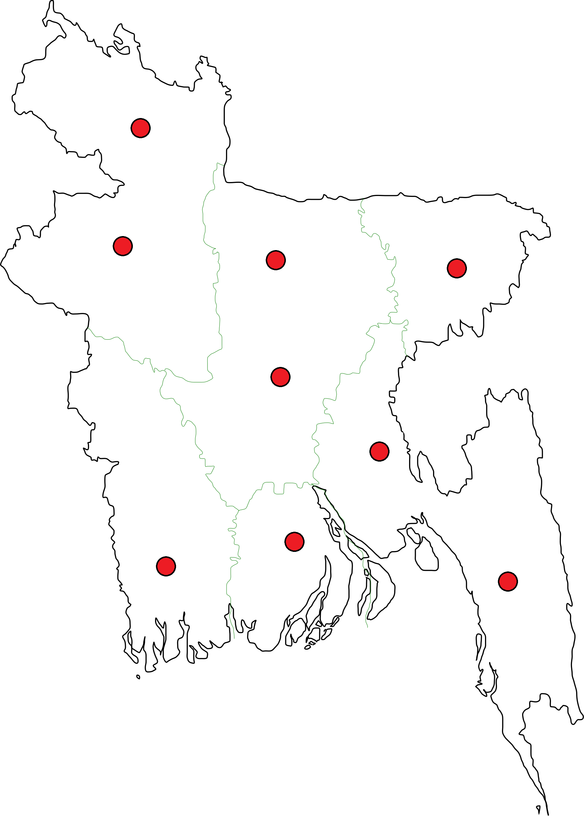

Slide 3
Application
Website
Contributor
Moderator
Admin
Divisions
Cultures
Map View
List View
Domains
Domains
Control Panel

Slide 4
